Slide 1
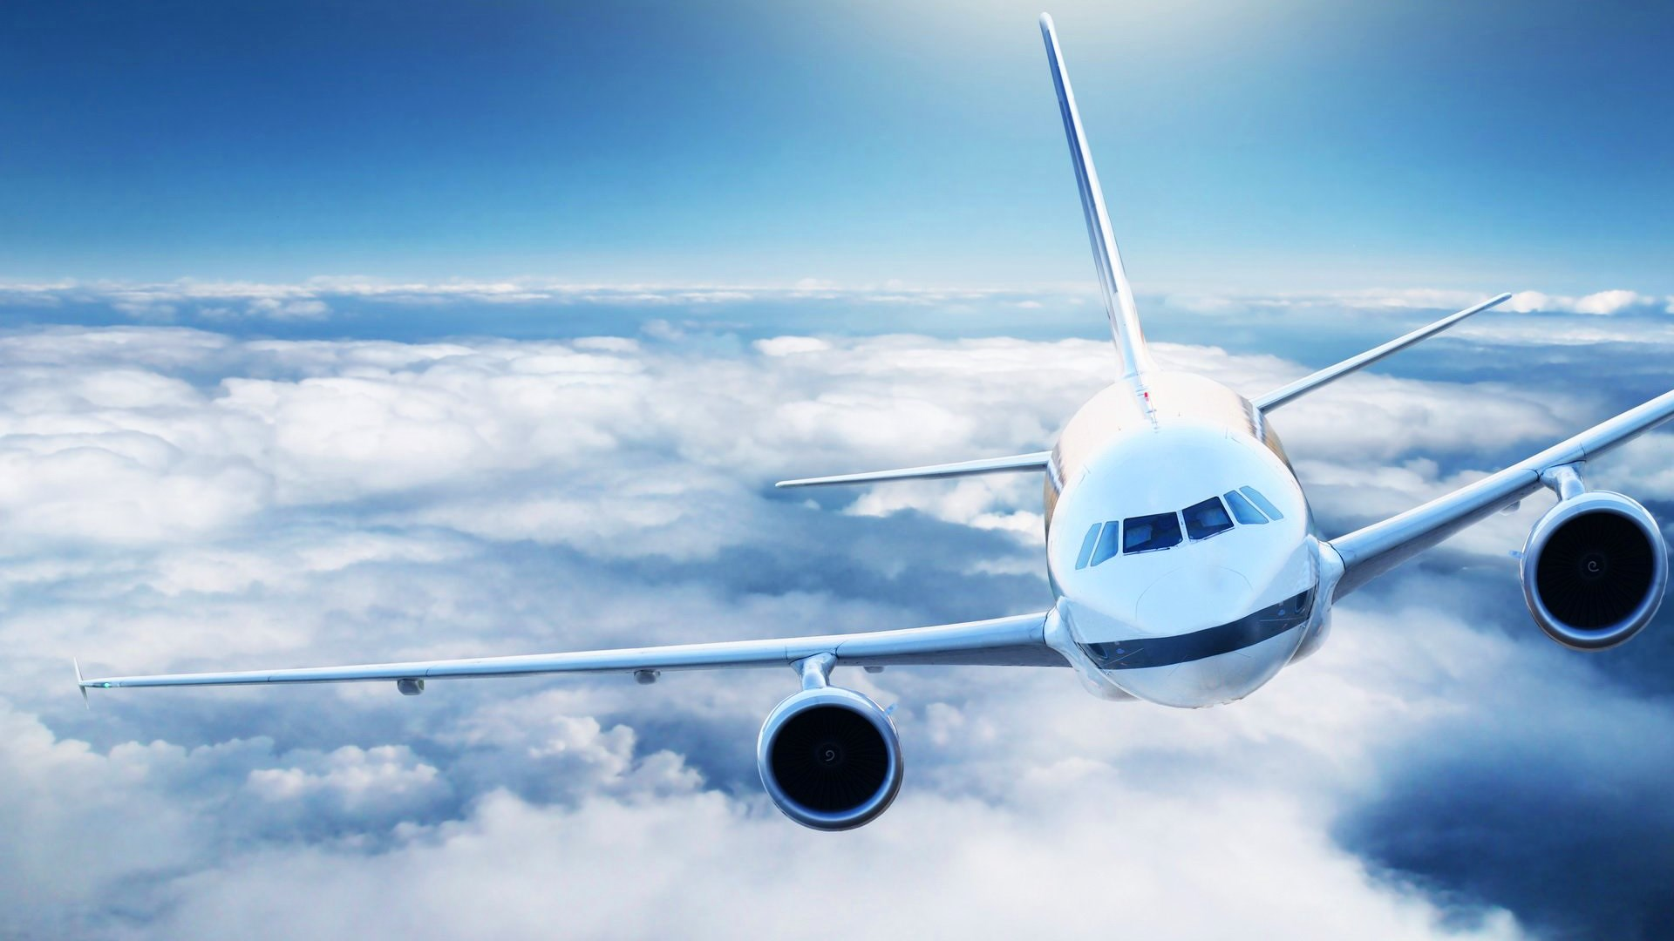
Flights & passengers
A c++ project

Slide 2
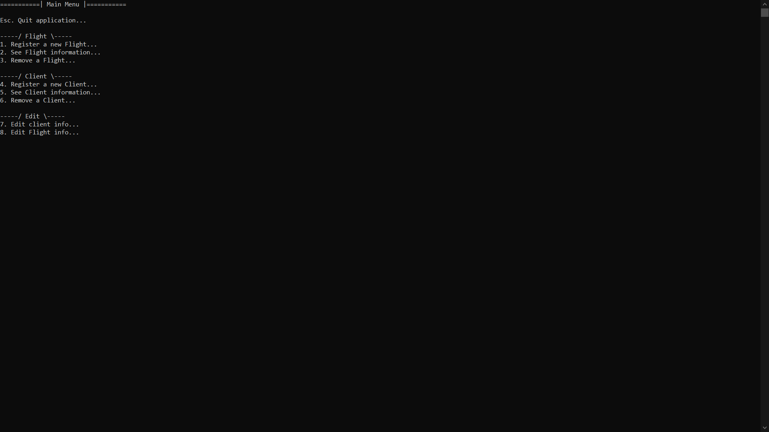
Who we are?
We are:
1. Martin Sevov – Developer, Team manager
2. Boris Kanev – Developer
3. Hristo Hristov – Quality manager

Slide 3
What is Flights and Passengers?

Slide 4
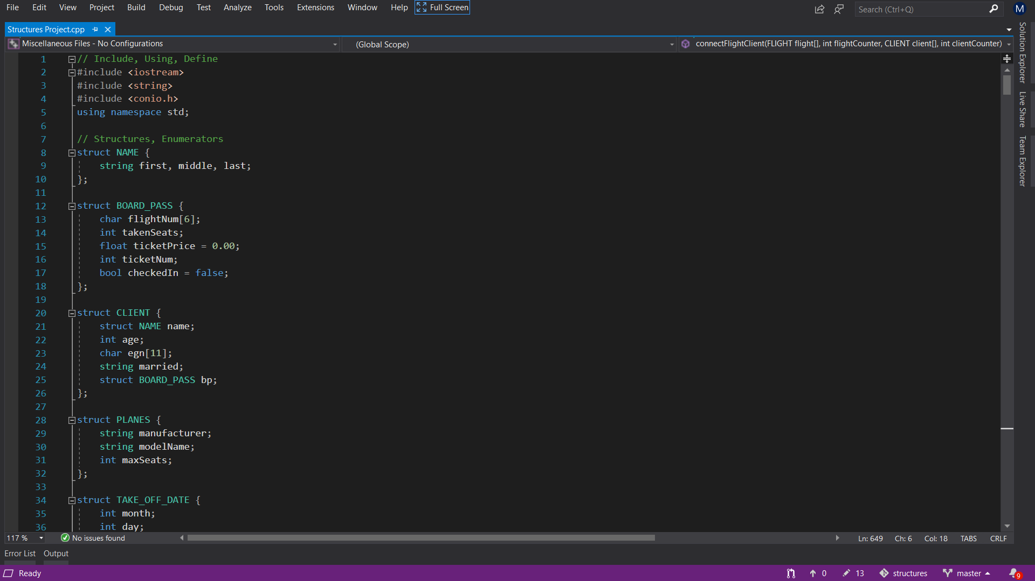
How we made the program?
It was made in C++ through Visual Studio

Slide 5
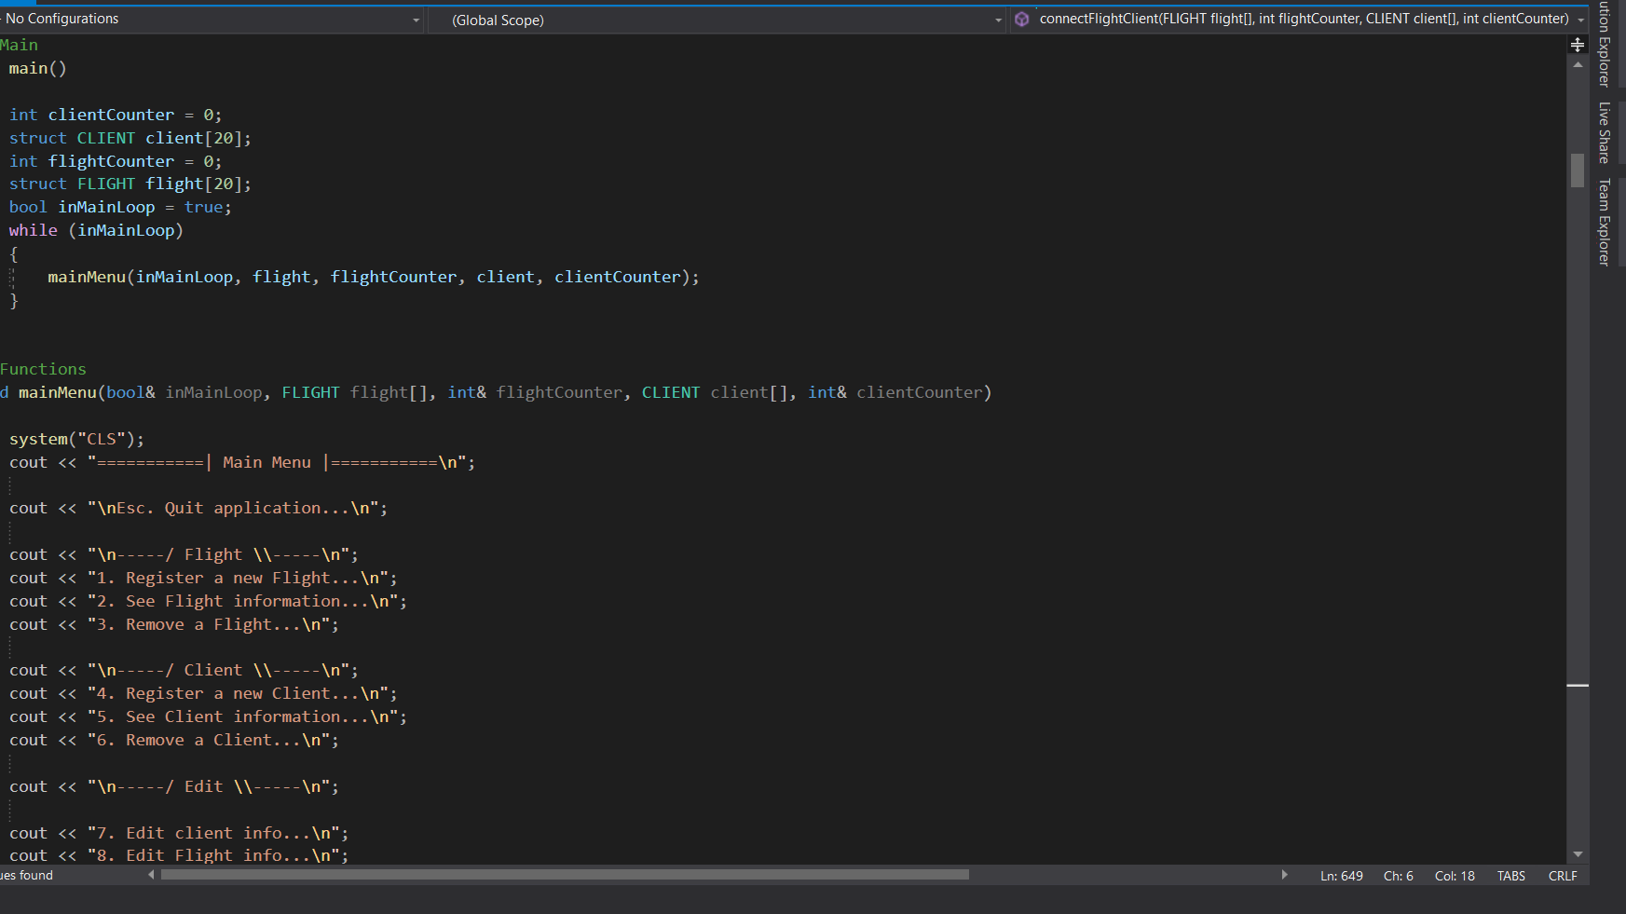
Main Menu
The main menu layout provides easy navigation through the program.

Slide 6
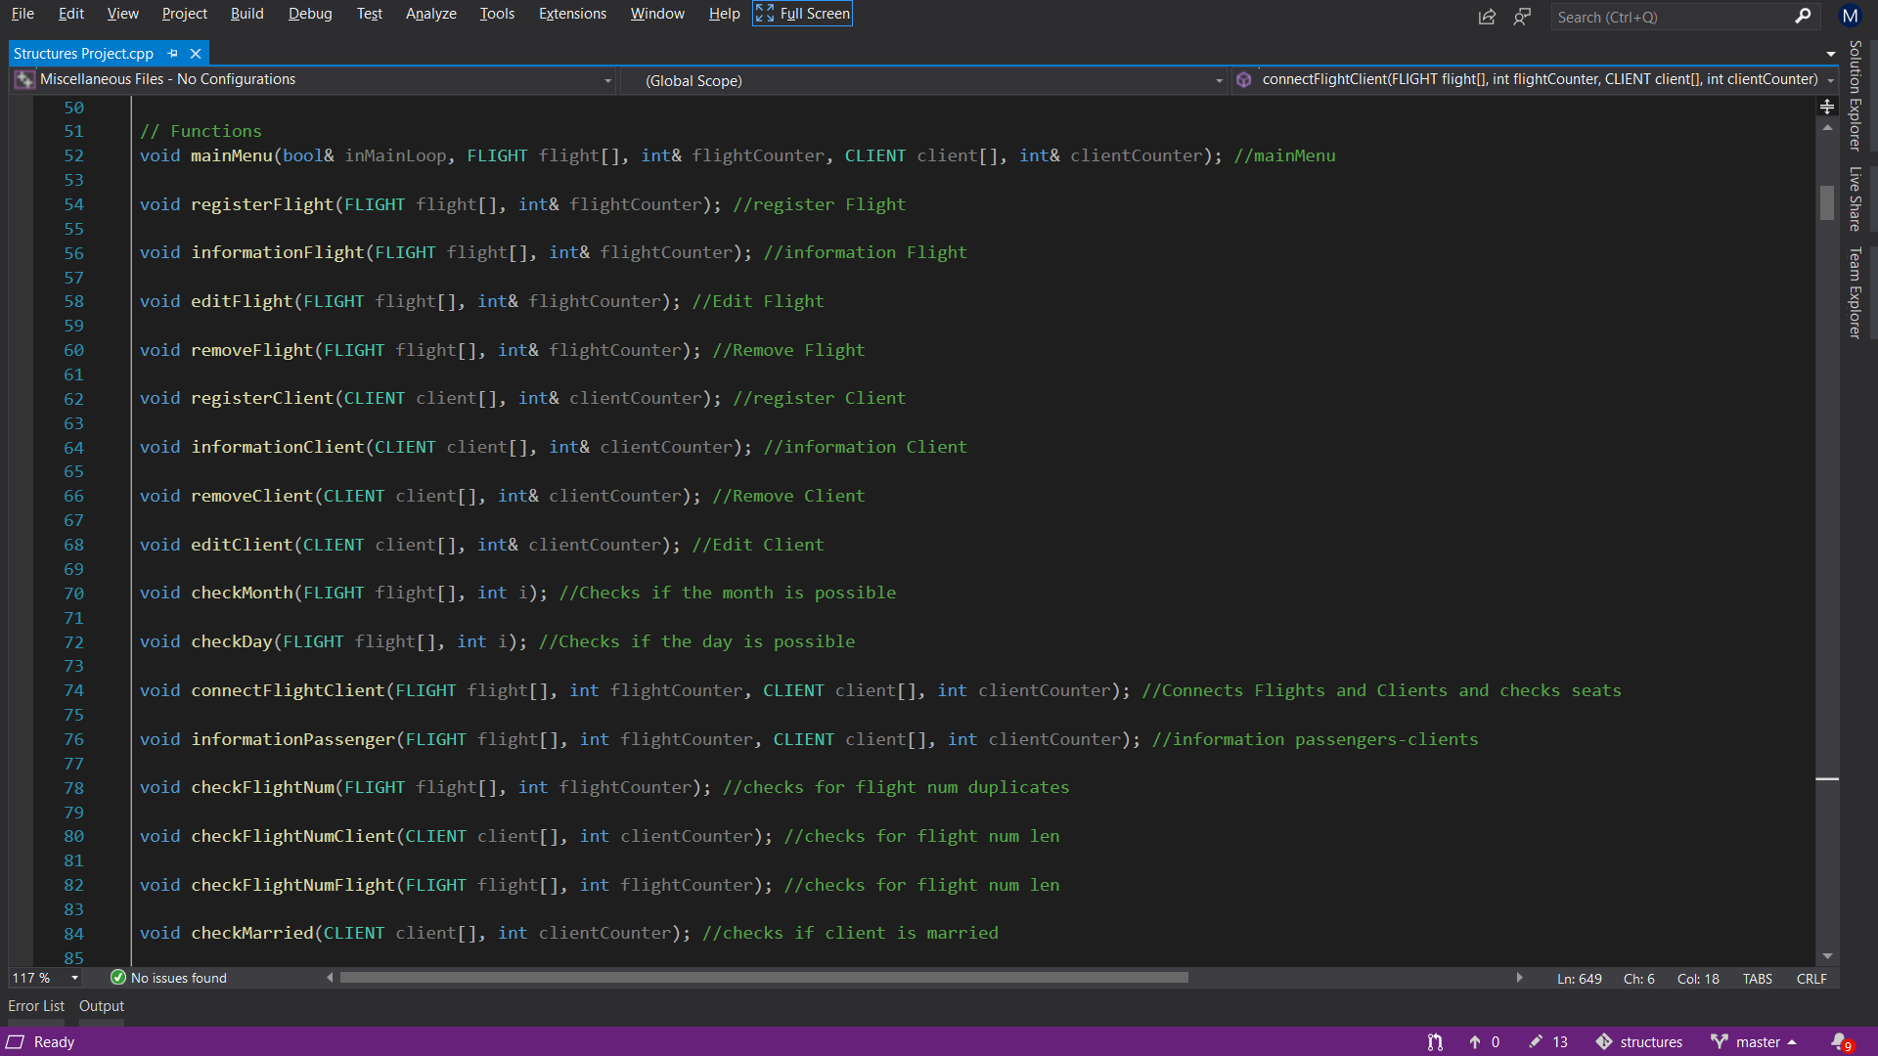
Different functions
Functions are used to shorten the code

Slide 7
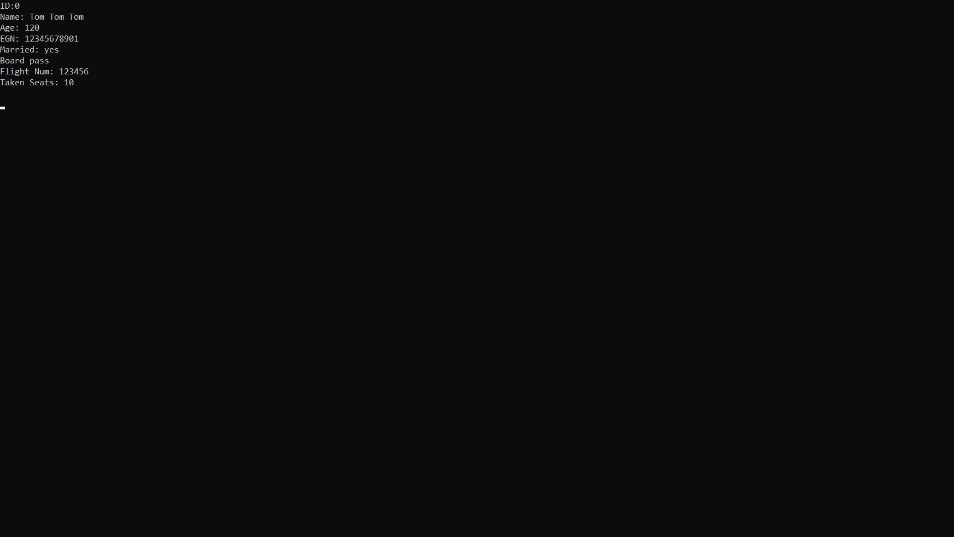
Client Information
The Clients are the first major structure
It holds information about the client like:
EGN
Names
Age
Married status
Etc.

Slide 8
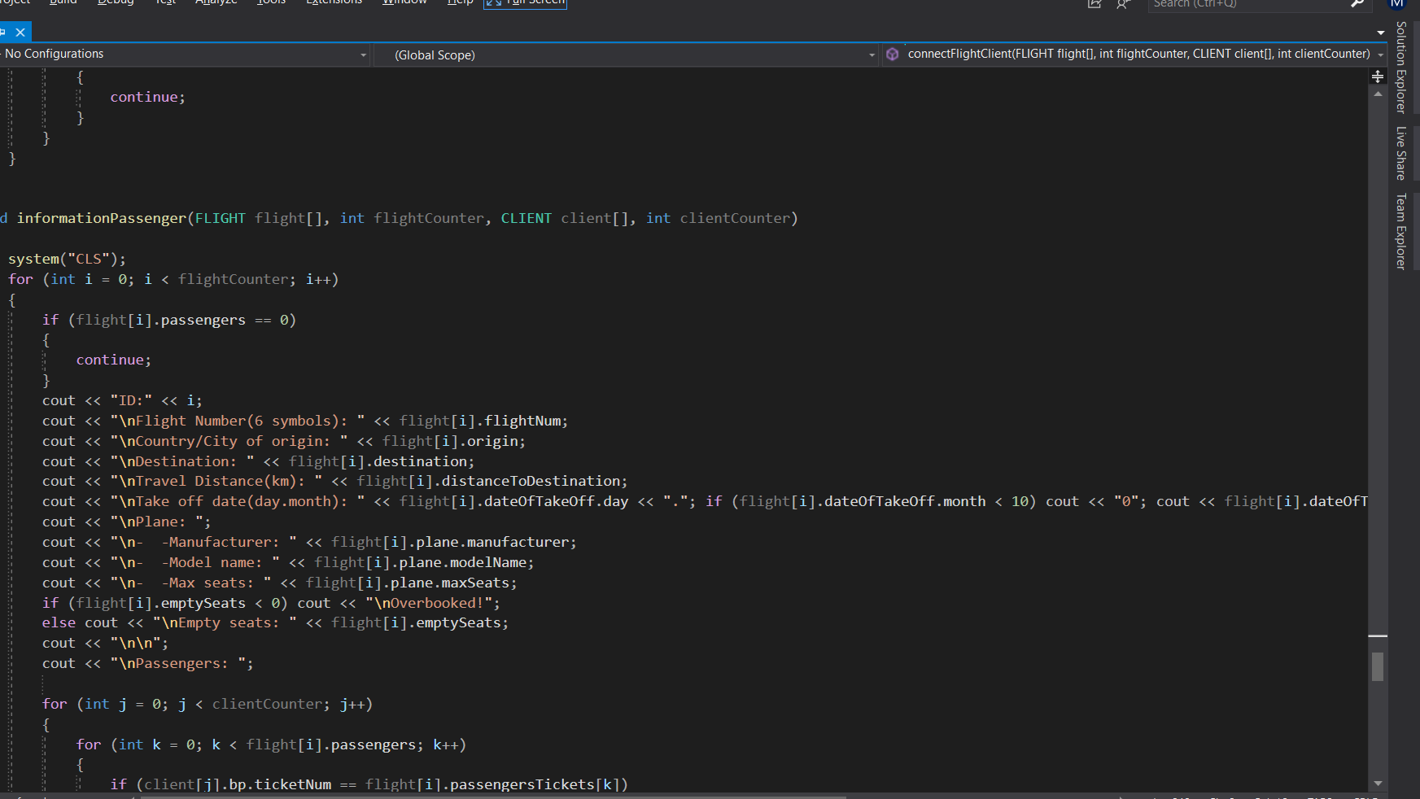
Flight informatioon
The Flights are the second major structure
It holds information about the flight and the plane:
Take of date
Origin and Destination
Distance
Plane manufacturer
Max seats
Etc.

Slide 9
Thank you for YOur attention
Martin Sevov
Boris Kanev
Hristo Hristov

Slide 10
Code
Now we will show you the code

Slide 11
Q&A
If you have any questions please ask.

Slide 12
adventure time
Come on grab your friend. We are going to very distant lands
With jake the dog and finn the human the fun will never end it's adventure time

